Slide 1

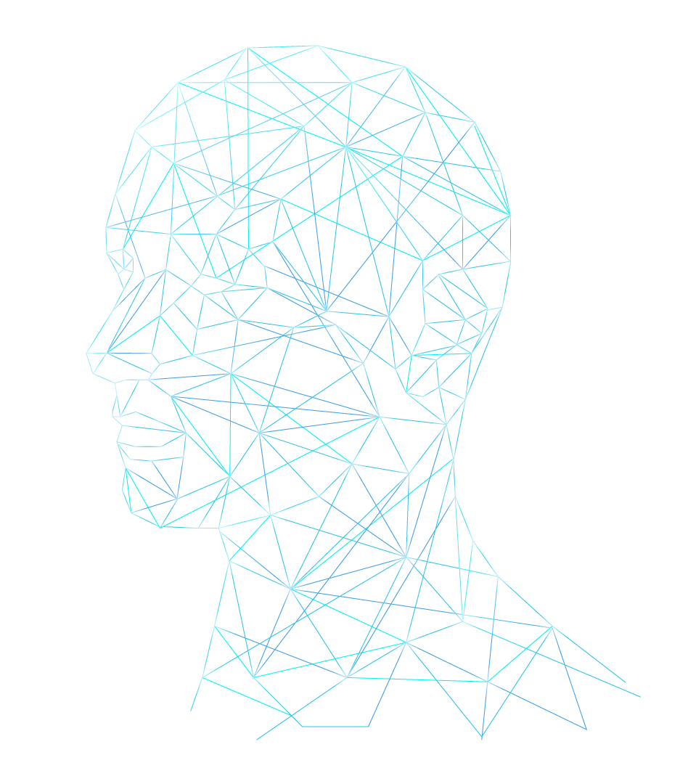
Project Plan & RMMM: Real-time Stabilization and 3D Reconstruction of Hand Gestures and Finger Movement Traces Using LED-Equipped Gloves
Presented by Team 5: Deniz Acikbas, Soham Naik, Zaynab Mourtada, Alan Raj

Slide 2
Introduction
IoT
LED Gloves
ML
Image Processing & ML
Captures hand movements for gesture tracking.
Stabilizes gestures with image processing; ML (Kalman filters, LSTM-CNN) refines and smooths movements.
3D
3D Visualization
I
Mobile App & AR/VR
Renders smooth gestures in real-time 3D.
The mobile app manages gesture tracking and integrates it into AR/VR environments.
Notes:
Zaynab

Slide 3
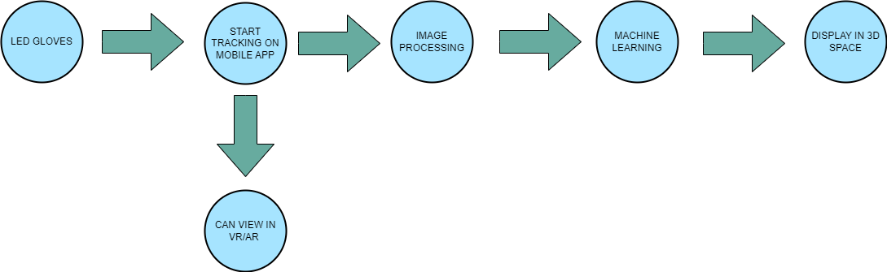
How Does the Process Work?
Notes:
Zaynab

Slide 4

Real World Impact
HOW IT WORKS
Accessible
New Computer
Makes AR/VR use available to everyone
Replaces traditional desktops and laptops with AR/VR technology
Modern GUI
AI Integrated
Replaces the traditional GUI system with modern GUI
Uses AI to adopt user`s gestures
Parkinson`s
Autism
No more struggle due to Parkinson's
No more struggle due to Autism (Low Functioning)
Notes:
Deniz: Talk about real world impact, mention how it will benefit patients with parkinson’s disease

Slide 5

Iterative SPMP Process & Estimate Revisions
Initial Planning:
Started with broad assumptions based on key project components (Image Processing, Machine Learning, VR/AR Integration).
Estimation Techniques Used:
Lines of Code (1,920 hours) – Focused mainly on development effort.
Function Point (1,192 hours) – Estimated the complexity of different modules but missed the broader scope.
Task-Based (1,100 hours) – Captured the overall project scope, including development, testing, and management.
Reconciled Estimate:
Final total effort reconciled to 1,291.1 hours, weighted more toward task-based estimates for comprehensive coverage.
(LOC - 0.2) | (FP - 0.3) | (TB - 0.5)
Notes:
Soham: description of the process the team used to create the SPMP (3-5 minutes - might SHOW some of the iterations of estimates and/or task network and why the team changed from version to version)
To begin, our team approached the development of the SPMP by first outlining the major components of our project, such as image processing, machine learning, and mobile app development. Initially, we made broad assumptions about how long each part of the project would take, so we applied several estimation techniques to refine our approach.
We used three main estimation techniques:
The Lines of Code (LOC) estimate, which came out to about 1,920 hours. This method focused primarily on development, but didn’t account for other areas like testing or management.
The Function Point estimation technique, which measured the complexity of different project modules. This estimate gave us about 1,192 hours, but it still didn’t fully capture tasks related to project management or testing.
The Task-Based estimate was the most comprehensive, reflecting not just development but also project management, testing, and integration. This estimate came out to around 1,100 hours.
As you can see, our Lines of Code estimate is notably different from both the Function Point and Task-Based estimates. This is because, at this early stage, we didn’t have a strong basis for our LOC estimate. We expect these estimates to become more accurate as the project progresses.
To account for the differences, we reconciled the estimates by applying a weighted formula, ultimately arriving at a final projected project time of 1,291.1 hours. We gave the Task-Based estimate the most weight, at 0.5, followed by Function Point at 0.3, and Lines of Code at 0.2, to arrive at this final number.

Slide 6
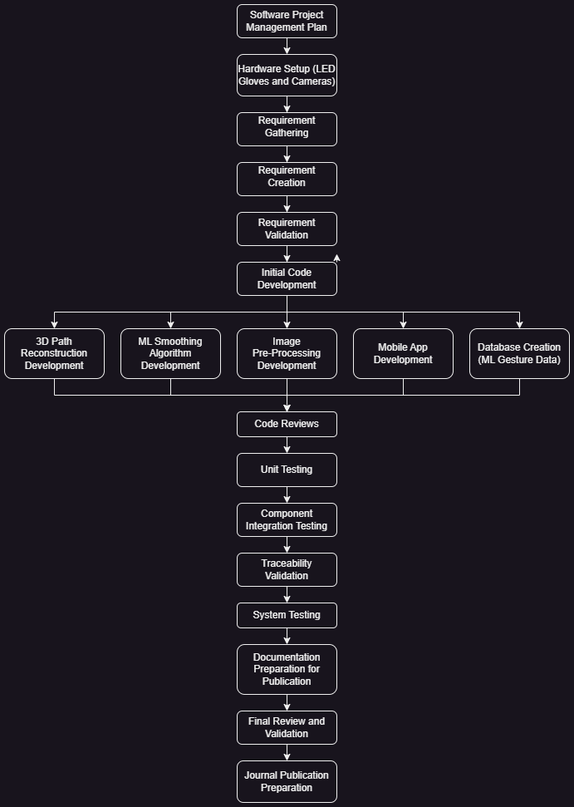
Task Network Adjustments & Key Takeaways
Adjusted the task network to allow for parallel execution
3D Path Reconstruction Visualizer
ML Smoothing Development
ML Gesture Database Creation
Image Pre-Processing
Mobile Application Development
Reduced bottlenecks, improved collaboration, and optimized the timeline.
Notes:
Soham: description of the process the team used to create the SPMP (3-5 minutes - might SHOW some of the iterations of estimates and/or task network and why the team changed from version to version)
When it came to organizing our tasks, we realized that a linear approach would create bottlenecks, so we decided to run as many development processes in parallel as possible. These tasks primarily focus on code development, including:
3D Path Reconstruction and Visualization Development
ML Smoothing Development
ML Gesture Database
Image Pre-Processing Development
Mobile Application Development
By running these tasks in parallel, we can significantly reduce bottlenecks and improve collaboration and overall team performance. This parallel execution allows us to make faster progress and minimize delays.
Following this Task Network Timeline will help ensure we stay on track and avoid unnecessary hold-ups. As we progress, we expect to make further adjustments to the timeline, especially as new opportunities for parallel execution arise.

Slide 7
Project Scope
This project focuses on developing a mobile application that captures, stabilizes, and smooths virtual hand movements for patients with Parkinson’s disease, specifically for virtual writing.
Key features of this project include:
Gesture tracking and stabilization
Machine Learning for Gesture Smoothing
VR/AR Integration
Notes:
Alan

Slide 8
Project Timeline
HOW WE PLAN TO DO IT
Sept - Oct
Oct - Dec
Dec
Dec
Documentation & Planning
Integration
Prototype Development
Prototype Testing
Notes:
Zaynab

Slide 9
Roles and Responsibilities
Deniz Acikbas
Soham Naik
Mobile Application and AR/VR Integration
Image Processing
WHAT SETS US APART
Zaynab Mourtada
Alan Raj
Machine Learning
3D Simulation
Notes:
Alan

Slide 10
Risk Table
Low Probability | Medium Probability | High Probability
Technical requirements outside team experience Privacy filtering failure Hardware failure or incompatibility Data loss or corruption during frame capture Security vulnerabilities in mobile app | Inconsistent LED tracking due to ambient lighting Real-time processing performance limitations Misalignment between image processing and machine learning Insufficient training data for machine learning Changes in hardware specifications during development Unclear or delayed requirements from stakeholders Inadequate pre-processing performance | Machine learning accuracy does not meet expectations
Notes:
Alan: Present all risks and their impact

Slide 11
Risk Mitigation Strategies Overview
TECHNICAL GAPS | LED TRACKING ISSUES | PROCESSING & ML ACCURACY
Mitigation: Identify gaps early during planning. Action: Seek external consultants for specialized tasks. | Mitigation: Test in different lighting environments. Action: Adjust LED brightness and apply image processing techniques. | Mitigation: Optimize code performance and test ML early. Action: Simplify features, upgrade hardware, refine ML models.
Notes:
Zaynab

Slide 12
THANK YOU!

